Slide 1
Discrete Mathematics
Instructor: S. M. Vahidipour
Counting methods
Binomial coefficients and combinatorial identities

Slide 2
Binomial coefficients and combinatorial identities
Binomial theorem gives a formula for the coefficient in the expansion of (a+b)^{n}.
Since
(a+b) ^{n}= (a+b) (a+b)… (a+b) (a+b)
Term a^{n-k}b^{k} arises from choosing b from k factors and a from the other n-k factor.
C(n , k)

Slide 3
Binomial coefficients and combinatorial identities
Binomial theorem: For any real numbers a, b, and a nonnegative integer n:
(a+b)^{n} = C(n,0)a^{n}b⁰ + C(n,1)a^{n-1}b¹ + …
+ C(n,n-1)a¹b^{n-1} + C(n,n)a⁰b^{n}
Examples
  n=1: a+b
  n=2: a²+2ab+b²
  n=3: a³+3a²b+3ab²+b³
  …

Slide 4
Example
The coefficient of x⁵y² in (x+y)⁷ is
C(7,2)=C(7,5)=21
The coefficient of a⁵b² in (2a-3b)⁷ is
C(7,2)(2)⁵(-3)²=21*32*9
The coefficient of x²y³z⁴ in the expansion (x+y+z)⁹
(x+y+z)⁹=(x+y+z) (x+y+z)… (x+y+z)(9 terms)
C(9,2) for the x’s, C(9,3) for the y’s
C(9,2)C(9,3)= 9!/2!3!4!=1260

Slide 5
Pascal’s Triangle
1
1 1
1 2 1
1 3 3 1
1 4 6 4 1
1 5 10 10 5 1
1 6 15 20 15 6 1
1 7 21 35 35 21 7 1
1 8 28 56 70 56 28 8 1
1 9 36 84 126 126 84 36 9 1
…

Slide 6
Binomial coefficients and combinatorial identities
Theorem : For 1 < k < n,
C(n+1,k) = C(n,k) + C(n,k-1)
This comes in handy when you already know the value of the binomial coefficient for a smaller set
Example: Assume you have all computations performed for C(5,i), i=1..5, then, what is C(6,4)?
C(6,4)=C(5,4)+C(5,3)=5+10=15

Slide 7
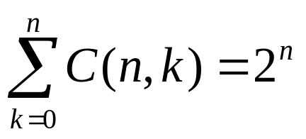
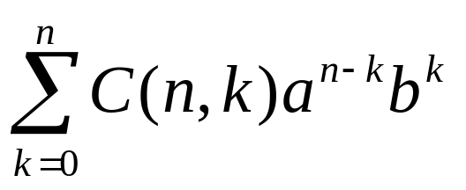
Example
The sum is the same as the sum in the Binomial theorem.
a=b=1 and 2^{n}=(1+1) ^{n}

